Slide 1
Ocean Surface Generation and Rendering
Thomas Gamper
Research Division of Computer Graphics
Institute of Visual Computing & Human-Centered Technology
TU Wien, Austria

Slide 2
Overview
Motivation
Wave spectra
Level of detail
Summary
Future Work

Slide 3
Motivation
Generating and rendering of believable ocean surfaces represents a permanent topic of interest in computer graphics
Even more so in context of real-time rendering
Problems:
Model quality
Performance

Slide 4
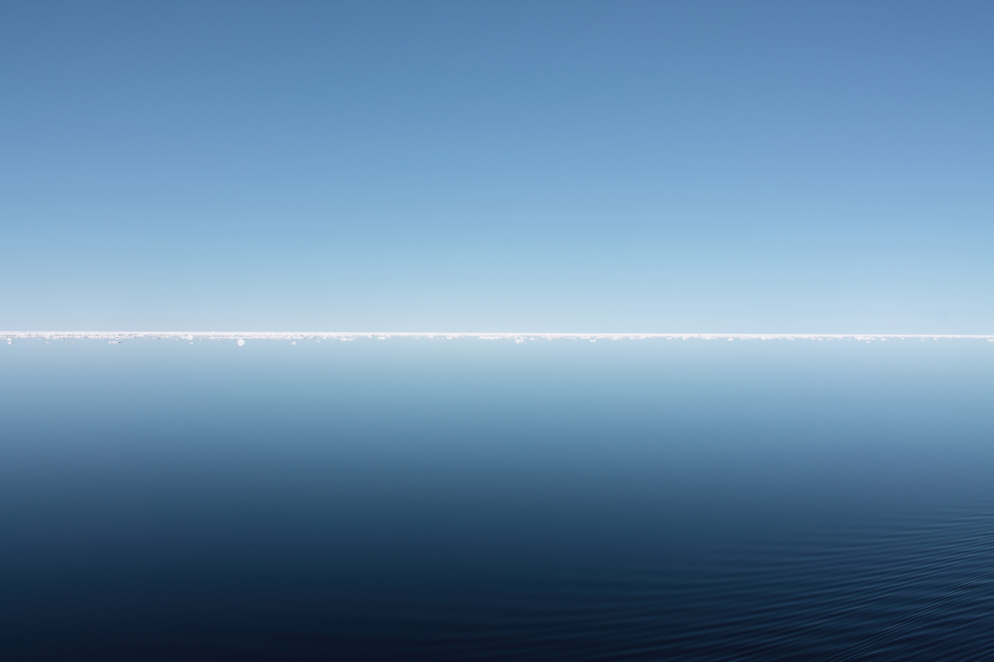
Motivation

Slide 5
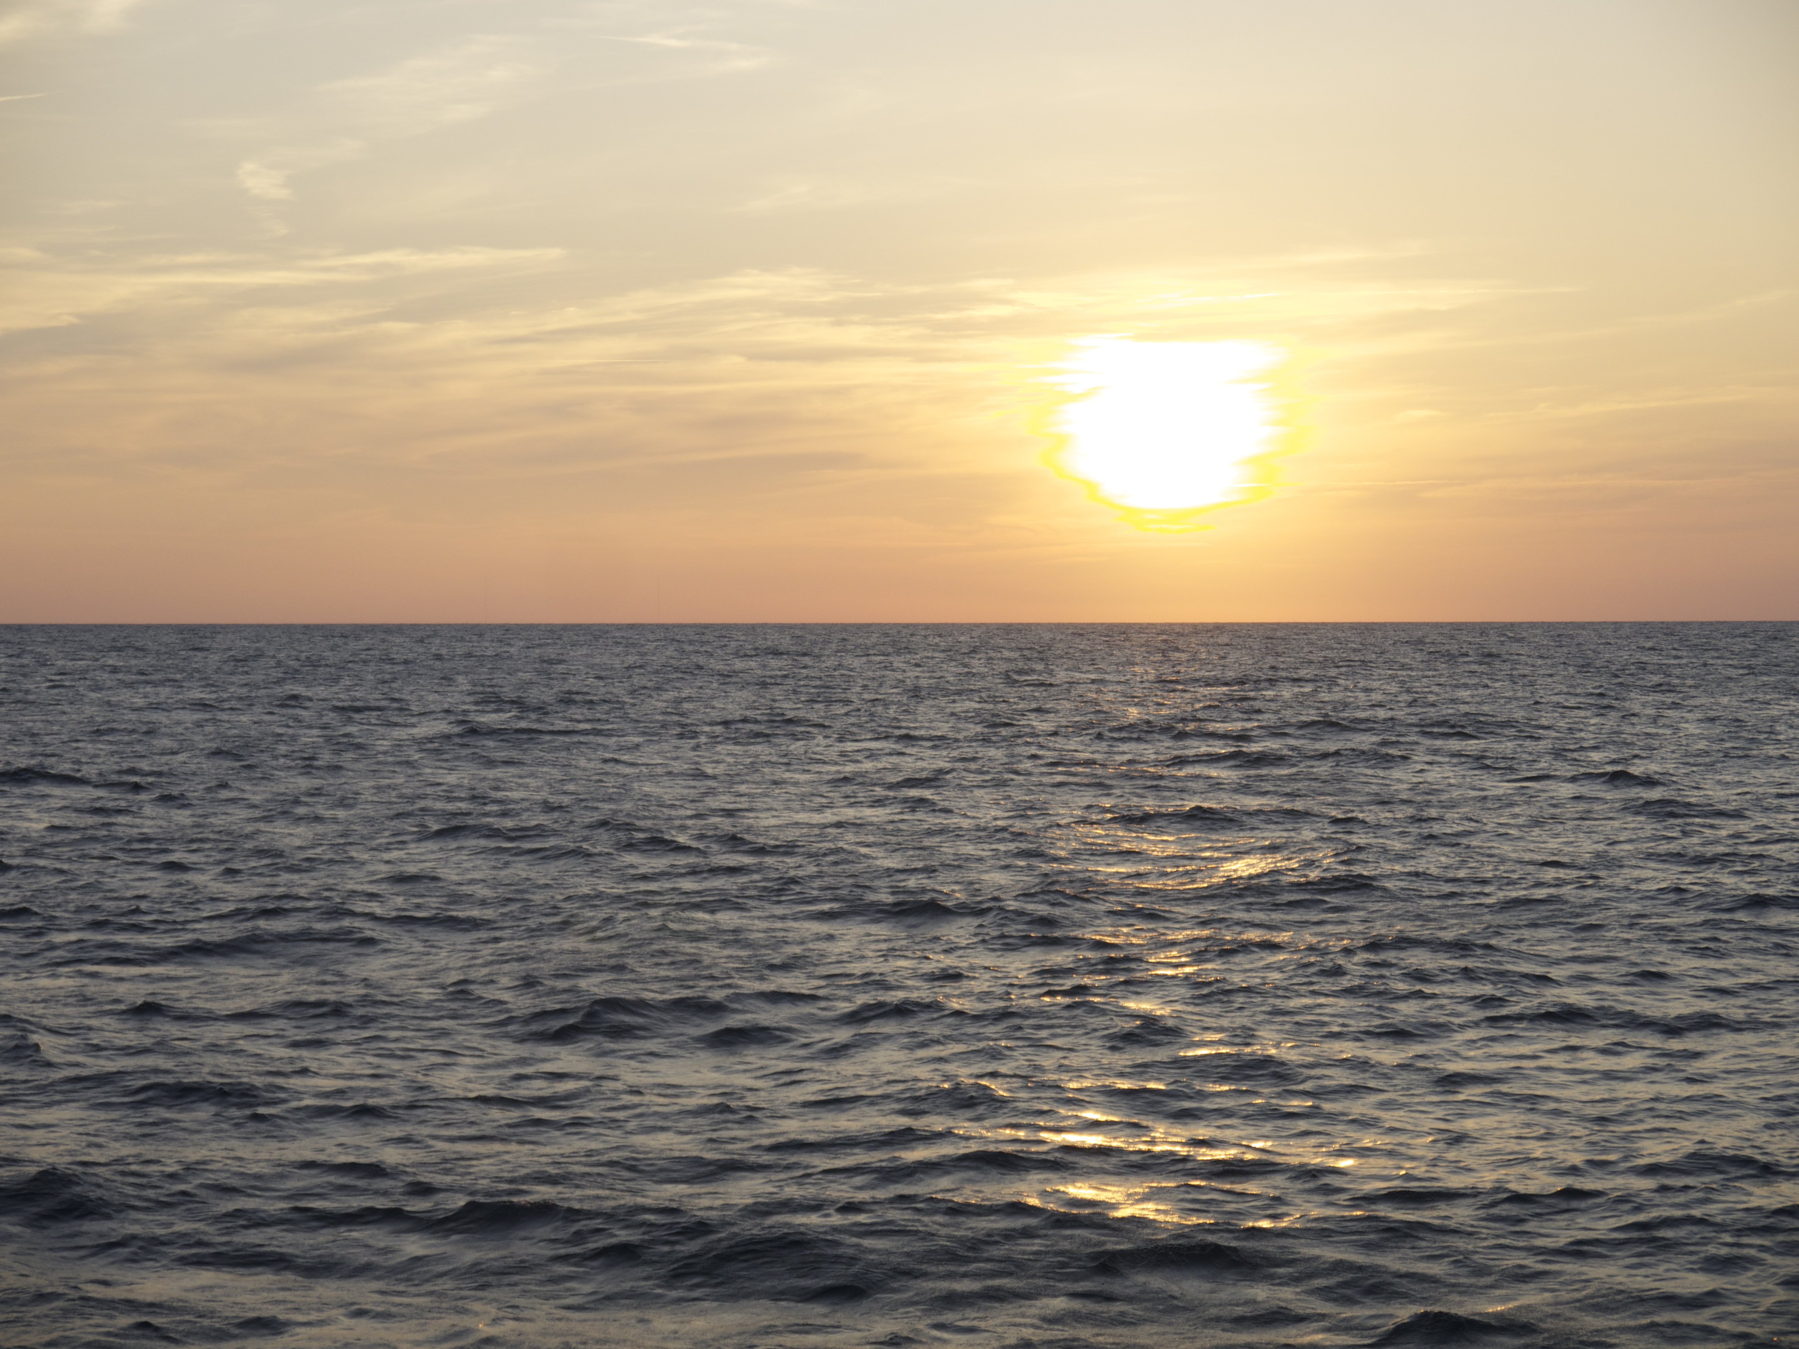
Motivation

Slide 6
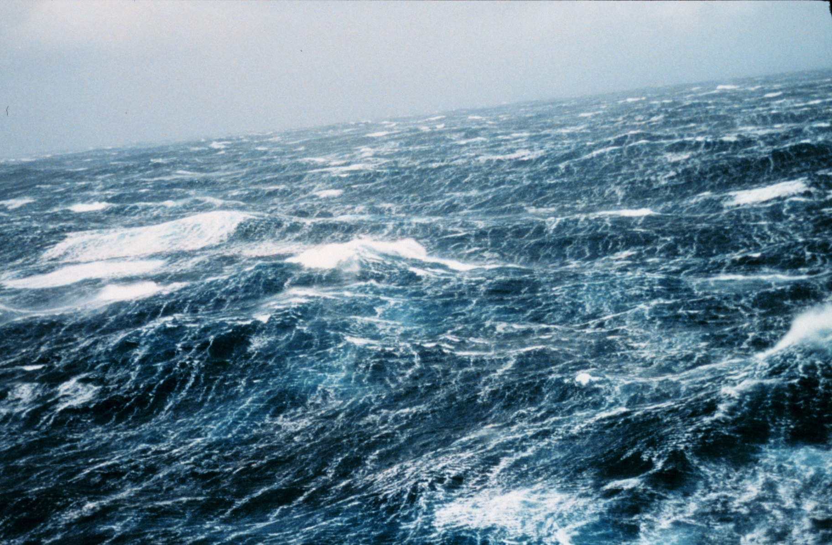
Motivation

Slide 7
Related Work
Choppy wave algorithm [Tessendorf1999]
Employs wave spectrum concept from oceanographic reasearch
Horizontal and vertical displacements
First order partial derivatives for normals and whitecaps
Adapted for real-time operation
Meshing [Hinsinger2002, Johanson2004]
Lighting [Bruneton2010a, Bruneton2010b]
Whitecaps [Dupuy2012]

Slide 8
The wave spectrum

Slide 9
Results (1/2)

Slide 10
Results (2/2)

Slide 11
Summary
Contribution 1: evaluate wave energy models
Contribution 2: multi-resolution level-of-detail

Slide 12
Future Work

Slide 13
Headline
Level 0
Level 1
Level 2
Hint: Do NOT use bullet lists wherever possible !!!

Slide 15
Sometimes a dark background is better. Use this template.

Slide 16
Thank You for your Attention!
Don't forget to include a last slide that contains teaser images or a video or something else that reminds people about what you said.
It might well be that this slide will be on the screen during the whole discussion!

